Slide 1



An Application to Optimize Lap-times for Race Cars
Group Members:
Alaa Bashir | ge73cec
Ankit Khot | ge73xuq
Máté Kelemen | ge49pil
Supervised by: Jan Janse van Rensburg and Steve Schaefer

Slide 2

Outline:
Goals and Problem Statement
Introduction
Literature Review
Interface to a 3D engine (Unreal)
Summary

Slide 3
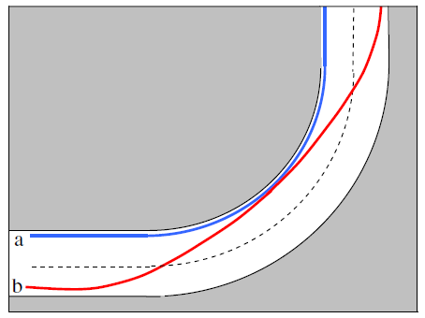
Goals and Problem Statement
Goals :
Determine optimal racing lines
Minimize total lap time
Simulate the results for different tracks
Problem Statement:
Optimal race lines is a dual problem
Compromises are needed
Car dynamics must be considered

Slide 4
Milestones
Familiarize ourselves with MATLAB and Simulink
Literature Review
(Optimizing the path)
Literature Review
(Vehicle dynamics constraints)
Start
Controller controlled Vehicle in Unreal engine
Finding Optimum path for a point mass
Finding Optimum lap time for a point mass

Slide 5
Milestones
Extending point mass model for single track and double track models
Generalizing the model for different race tracks

Slide 6

Introduction
Project significance:
Racing, gaming industries and transportation analysis
Challenges:
Complex and nonlinear
Numerous parameters

Slide 7
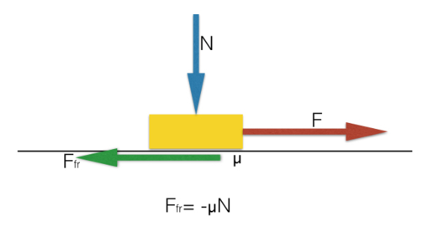
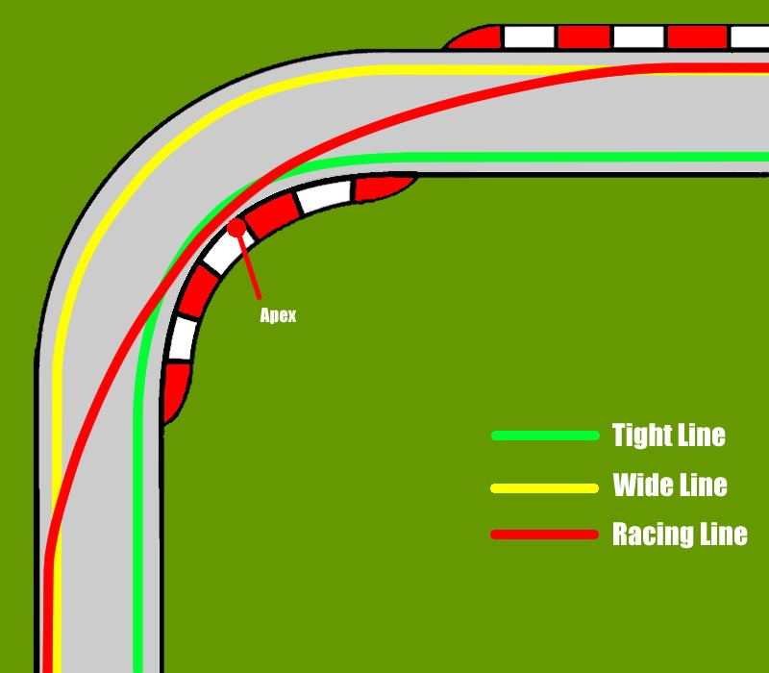
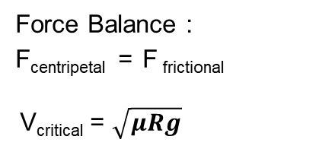
Illustrative example : L-bend
Forces and constraints on a body going around the corner
Force Balance :
F_{centripetal} = F _{frictional}
V_{critical} = $\sqrt{μRg}$
Results:
V_{critical _A} | 12.13 m/s
V_{critical _B} | 14.35 m/s
V_{critical _C} | 18.79 m/s
t_{A} | 2.62 s
t_{B} | 2.70 s
t_{C} | 2.01 s
R_{B}
10 m
R_{c}
R_{A}
10 m
Source : https://lifeatlean.com/what-is-the-racing-line/

Slide 8

Literature Review
Several researches covered the geometric consideration
“Race driver model” by F. Braghin, F. Cheli, S. Melzi, E. Sabbioni covered the geometric consideration and vehicle dynamics

Slide 9
Literature Review: Roadmap
Shortest Trajectory
Trajectory Planning
Optimum trajectory
Minimum Curvature
Trajectory
Vehicle‘s Dynamics
Optimum Lap time

Slide 10
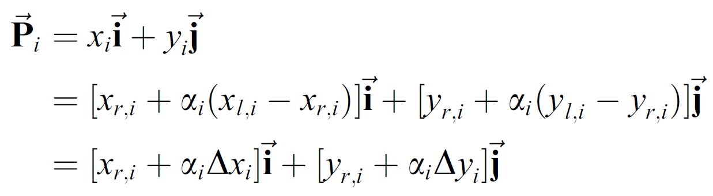
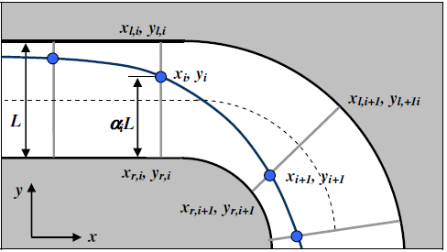
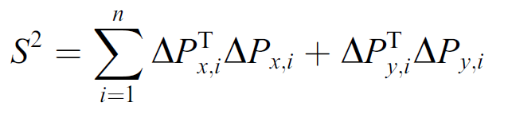
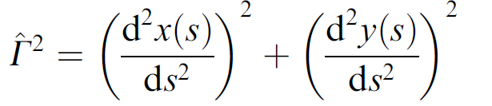
Trajectory Planning
Track Discretization
Shortest Trajectory
Estimate line integral of the track:
Minimum curvature trajectory
Find the track curvature Ѓ using:

Slide 11




Trajectory Planning
Minimum curvature trajectory
Interpolate track points with piecewise cubic splines
(Numerically) integrate curvature on the entire path
Minimize integrated curvature with respect to the track point coefficients
Spline segment and its derivatives
$$x\left(t\right)=a_{0}+a_{1}t+a_{2}t^{2}+a_{3}t^{3}$$
$$x′\left(t\right)=a_{1}+{2a}_{2}t+{3a}_{3}t^{2}$$
$$x′′\left(t\right)={2a}_{2}+{6a}_{3}t$$
Curvature of a spline segment
$$κ= \frac{x′×x′′}{{\left|x′\right|}^{3}}$$

Slide 12
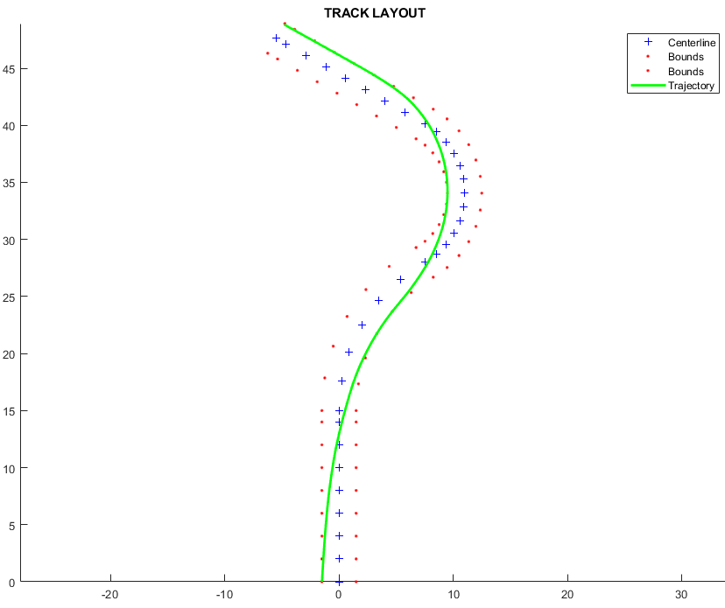
Trajectory Planning
Minimum curvature trajectory (MATLAB)

Slide 13
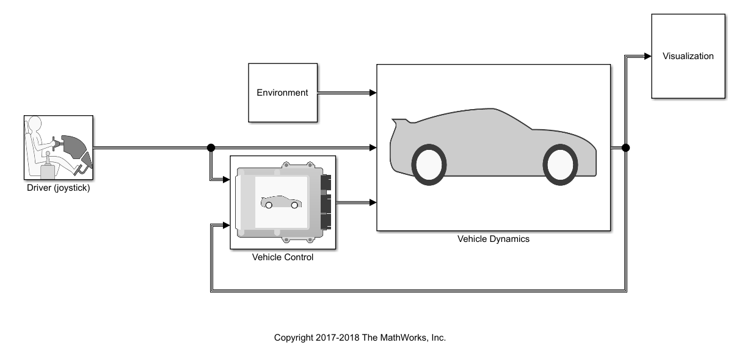
Interface to a 3D engine (Unreal+ Simulink)
User-controlled simulation
Provides a reference lap time

Slide 14
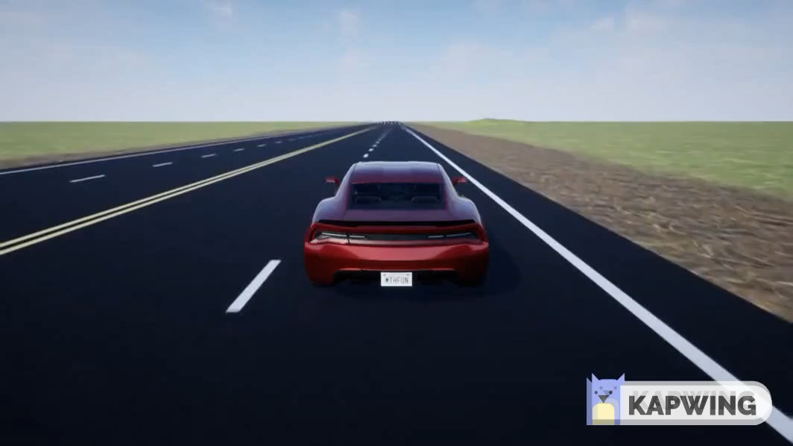
Interface to a 3D engine (Unreal+ Simuink)

Slide 15

Summary
Project goals, importance and challenges
Literature Review : two solutions possible
Shortest path
Least curvature path
Illustrative example with a simple L-bend.
MATLAB script for path optimization
Simulink model with 3D visualization

Slide 16


